Slide 1
Bitcoin – nuts and bolts [scripts + network + blocks]

Slide 2
Scripts in practice
scripts let us determine conditions of payment
most nodes whitelist known scripts
99.9% are simple signature checks
~0.01% are MULTISIG
~0.01% are Pay-to-Script-Hash
remainder are mistakes, proof-of-burn
not much diversity at all
1

Slide 3
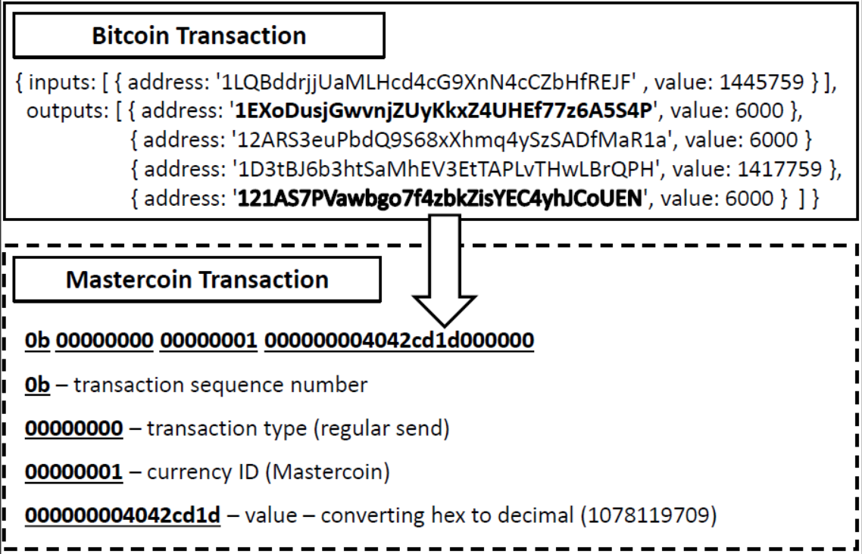
Proof of burn
PoW, PoS
destroy coins
benefits?
maintain scarcity
alternative to PoW
Slimcoin
bootstrap new currency
notary public
overlays (Mastercoin, Counterparty)
2
Notes:
-By "burning" a tranche of bitcoins I just mean sending them to an address which is unspendable. The precise technical details of this will vary from cryptocurrency to cryptocurrency. With Bitcoin, any address which is [the RIPEMD160/SHA256 hash of] a script that evaluates to false will do. So, the script should do a "deliberately silly" thing - instead of things like "check such-and-such signature, and put the validity result on the stack", it should do something like "add 2 and 2, and now check if what's on top of the stack is equal to 5". (Or just "push 4, and check if it's equal to 5". Anything of that sort.) (https://en.bitcoin.it/wiki/Proof_of_burn)
-maintain scarcity
-similar to when government’s contract money supply
-alternative to PoW – a *different* way to make effort
-with PoW, you spend in terms of energy for mining
-in this case, you spend coins directly – auction for who gets to mine the next block!
-no pollution!
-inherently wasteful though
-The idea behind these consensus strategies should be pretty obvious: Find something that:
is hard to do.
is easy to verify.
enforces a linear history.
PoW is trivial, you know it of course: Find a hash that's smaller than a given value.
PoB can be done in such a way that you send out a transaction which burns some of your money. If you burn the most (possibly combined with other criteria, a lot of proposals factor age of the coins in; not necessarily much of your money), you win. Others will mine (I use the word "mine" because "burn" could lead to confusion.) on top of your block. You, yourself, can take transactions of other miners burning their coins and add them to your block, meaning that you burn their coins if you win. Of course, you need a way of others telling you your transactions. Sounds hard at first, I mean why would they give you transactions to put into your block, burning their money. However, it's pretty obvious why they would to this: It's necessary to tell others about the transactions burning their money in order to propagate their block. So you receive blocks burning other miner's money, try to burn your own money on top of that block's parent, burning that other miner's money, too. If your block burns the most money, you win and get the block reward.
PoS, on the other hand, tries a lottery approach. There is a certain amount of money at stake and the bigger your share of that money is, the higher your chances of winning. It's like lining the coins of everyone up, say, there are n coins in total, all numbered from 1 to n. Then, a random number r ∈ [1, n] is drawn. The owner of coin r wins and gets the block reward and possibly the money the others risked (or it's burned, or something else).
The 6000 satoshis sent to the Exodus address mark the transaction as a Mastercoin transaction (as well as providing the Mastercoin developers an extra $0.012 USD to use to fund the project). The recipient is taken as the 6000-satoshi output that does not encode data and is not the Exodus address, and the sender is taken as the owner of the address that the transaction spends from. There are also other types of transactions, such as currency issuance, price ticker updates, bets and decentralized exchange, and they all have their own transaction type, and a similar data protocol is used to determine the details of the transaction.

Slide 4
P2SH
Pay-to-Script-Hash
script specification
complex scripts
ease of use
pay to a value
efficiency gains
instead of sending coins to hash of this public key, send your coins to hash of this script
3
Notes:
-for instance, shopping at online marketplace, buyer may use MULTISIG
-this feature was added in later
-process – hash top value on stack, check whether it matches provided hash value,, execute a second step of validation – the top data value from stack is reinterpreted as a sequence of instructions and executed a second time as a script with rest of stack as input
-miners don’t need to maintain entire script in RAM, complexity is pushed to inputs

Slide 5
Escrow transactions
the purchase dilemma
third party
2-out-of-3 MULTISIG
OP_2 <A pubkey> <B pubkey> <C pubkey> OP_3 OP_CHECKMULTISIG
transaction
escrow
delivery of goods
redemption
dispute
4
Notes:
-Alice is making a purchase from Bob, she doesn’t want to pay until she receives the items, Bob doesn’t want to send until he has been paid
-they bring in Judy as an arbitrator
-coins are held in escrow on the blockchain
-this is all decentralized!

Slide 6
Green addresses
quick and/or offline transactions
third party
bank
‘green’ address
honesty guarantee
real-world guarantee
known address
history
reputation
Mt. Gox
5
Notes:
-Alice is making a purchase from Bob
-Bob may be offline and cant check blockchain for transaction
-or Alice may not be able to wait for six confirmations – suppose she wants food! E.g. Bob may be street vendor
-Alice requests bank to expedite a payment to Bob
-bank pays Bob accordingly from an address it controls
-bank pledges no double-spending
-only bank itself can do double-spend
-Alice shows Bob a transaction signed by the bank
-real-world guarantee – not cryptographic guarantee!
-the green address is very well-known
-bank will say – look at my past history, I haven’t done any double-spends before
-if bank is exposed, it will ruin its reputation
-address reuse pros and cons – compromise privacy – sender AND receiver – if you send to a public address, e.g. a gambling site, a political charity, etc.

Slide 7
micropayments
very small and continuous payments
tx fees!
combo payment
1. max. MULTISIG transaction
2. first payment – spend some coins, new tx
3. spend some more, new txs
4. terminate, send final tx
Bob signs and circulates
Input: x; Pay 42 to Bob, 58 to Alice
SIGNED(ALICE) SIGNED(BOB)
all of these could be double-spends!
Input: x; Pay 42 to Bob, 58 to Alice
SIGNED(ALICE)___________
...
Alice demands a timed refund transaction before starting
Input: x; Pay 04 to Bob, 96 to Alice
SIGNED(ALICE)___________
Input: x; Pay 100 to Alice, LOCK until time t
SIGNED(ALICE) SIGNED(BOB)
I’m done!
I’ll publish!
Input: x; Pay 03 to Bob, 97 to Alice
SIGNED(ALICE)___________
Input: x; Pay 02 to Bob, 98 to Alice
SIGNED(ALICE)___________
Input: x; Pay 01 to Bob, 99 to Alice
SIGNED(ALICE)___________
PROBLEM: Alice wants to pay Bob for each minute of phone service. She doesn’t want to incur a transaction fee every minute.
Bob
Alice
Input: y; Pay 100 to Bob/Alice (MULTISIG)
SIGNED(ALICE)
6
Notes:
-this could be for some streaming service, minutes-on-phone, Pay-as-you-go, etc.
-for max payment, Alice and Bob would both need to sign to redeem – coins effectively locked
-after first minute, Alice makes a transaction, spending one of the locked coins, returning rest to herself, and sends to Bob
-after second minute, Alice makes another transaction, spending another locked coin, returning rest to self, sends to Bob
-so on and so forth for every minute that she uses the service
-finally, she asks Bob to terminate the service and sends him a final transaction
-Bob signs and circulates, thereby redeeming funds
-can Bob use earlier transactions as double spends
-intermediate transactions are discarded – Bob has no benefit by publishing them – he loses money if he does

Slide 8
Lock time
{ "hash":"5a42590...b8b6b", "ver":1, "vin_sz":2, "vout_sz":1, "lock_time":0, "size":404,
...
}
transaction hash
housekeeping
not valid before
housekeeping
7
Notes:
-from transaction meta-data
-lock_time = block index or timestamp before which this transaction CANNOT be published

Slide 9
Lock time
micropayments
refund transaction
‘locked’
lock_t parameter
protection
scripts for
lotteries
coin mixing
8
Notes:
-before micropayment protocol starts, Alice and Bob both sign a transaction which returns all of Alice’s money to her
-miners cannot publish this transaction until the block specified in that parameter has been mined
-if transaction published before then, it will be regarded as invalid and discarded
-this guarantees she cant retrieve her money while the micropayments protocol is underway
-if Bob violates protocol, she can publish this to get all her money back
-what happens if protocol executes fairly and then Alice publishes refund transaction?
-can Alice cheat? Not pay Bob for final payment?

Slide 10
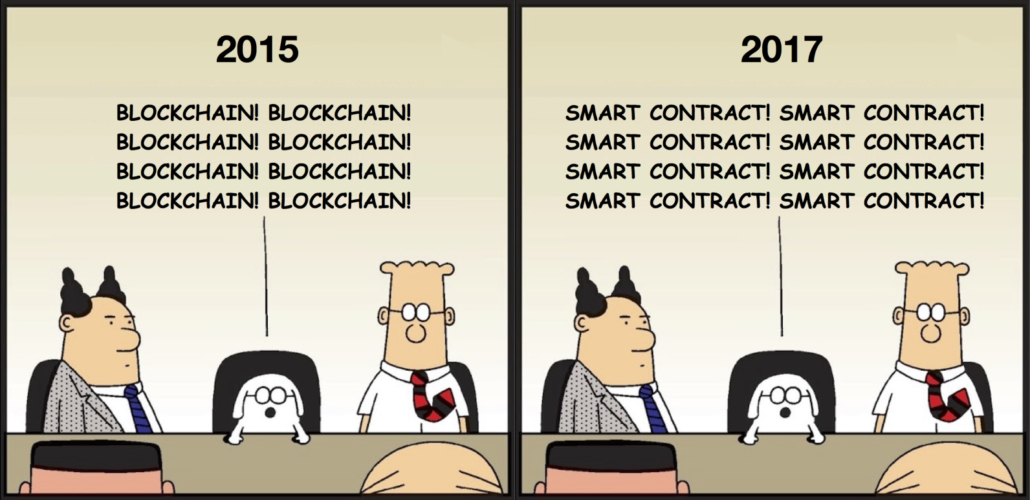
Smart contracts
contracts
decentralization
Ethereum
Turing-complete
DAO
9
Notes:
-traditional enforcement through courts and law
-here we have technological enforcement
-Turing-complete languages run on blockchain

Slide 11
blocks
why blocks?
overheads
data
mining overhead
consensus?
hash chain of blocks
hash tree within block
10
Notes:
-an optimization
-too much overhead if we were to add each transaction individually (data + mining overhead!)
-single unit of work for miners
-hash chain of blocks is MUCH shorter than hash chain of transactions (how?)
-consensus on each transaction would be crazy!
-verification would be much slower
-hash (Merkle) tree within block – to enable proof of membership property

Slide 12
blocks
block = header data + hash tree of transactions
Hash chain of blocks
prev: H( )
prev: H( )
prev: H( )
trans: H( )
trans: H( )
trans: H( )
H( ) H( )
Hash tree (Merkle tree) of transactions in each block
H( ) H( )
H( ) H( )
transaction
transaction
transaction
transaction
11

Slide 13
blocks
header
block hash
nonce
timestamp
difficulty level
mrkl_root
miners hash headers
12
Notes:
-for valid block, header has to start with x number of zeros as per difficulty
-why include difficulty level? So that person who downloads blockchain later can verify winning header is correct
-why is only header hashed during mining? Because hash is already a fingerprint of all transactions in block – and it would take too much energy to hash entire block.

Slide 14
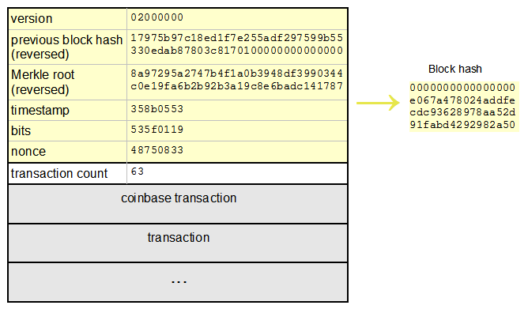
Block header
13
Notes:
The coinbase transaction is generated before the block is mined, not afterwards, because it must be included in the list of transactions just like all the others. It is the first transaction in the block, and its hash is used in exactly the same way as all the others when constructing the merkle root.
Once the coinbase transaction is created and the merkle root calculated, then the nonce is varied and the block is mined.

Slide 15
Coinbase transaction
"in":[ { "prev_out":{ "hash":"000000.....0000000", "n":4294967295 },
"coinbase":"..." }, "out":[ { "value":"25.03371419", "scriptPubKey":"OPDUP OPHASH160 ... ”
}
Null hash pointer
redeeming nothing
arbitrary
First ever coinbase parameter:
“The Times 03/Jan/2009 Chancellor on brink of second bailout for banks”
block reward
transaction fees
14
Notes:
-coinbase transaction creates new coins
-ALWAYS single input and single output
-input contains a NULL hash
-index n is always 0xFFFFFFFF (4294967295)
-value determined by algorithm
-special coinbase parameter – miner can put in any random information
-timestamping! Block mined *after* 3/1/2009

Slide 16
Bitcoin network
p2p, TCP
random topology
dynamic
bootstrap – seed node
flooding algorithm / gossip protocol
peers validate and forward
mempool
15
Notes:
-all nodes are equal, no master nodes, hierarchy, etc.
-if a node hasn’t been seen for 3 hours, other nodes start to forget it
-if a node gets a transaction that’s not in the blockchain, it validates, forwards, and stores it in mempool
-if it receives a transaction already in mempool, it doesn’t further broadcast it
-necessary so that flows terminate and loops don’t build in the network
-connect to seed node which introduces you to other nodes and so on and so forth

Slide 17
Bitcoin network
transaction checks:
transaction is valid
whitelist of scripts
outputs can be redeemed
fresh transaction
16
Notes:
-transaction is valid means format must be correct and scripts must return true
-super cautious on scripts since some have been known to cause errors
-outputs must not have been spent already
-if node receives transaction it has already seen, it doesn’t forward it
-why must *every* node do these checks for themselves?

Slide 18
Bitcoin network
5
Already heard that!
1
5
1
Hello World! I’m ready to Bitcoin!
7
7
8
8
getaddr()
getaddr()
1, 7
getaddr()
A→B
A→B
A→B
New tx!
A→B
3
3
6
A→B
6
2
2
A→B
A→B
A→B
4
A→B
A→B
4
A→B
17

Slide 19
Bitcoin network
transaction checks:
transaction is valid
whitelist of scripts
outputs can be redeemed
fresh transaction
block checks:
hash value correct
longest branch
18
Notes:
-hash value has to be valid and meet difficulty level
-node *only* forwards block if it is received on the longest branch – this minimizes forks building up
-checks on transactions in blocks?
-compare and remove for the most part! Only do transaction checks if there is a new transaction in the block

Slide 20
Double spends
double spend
race condition
miner breaks tie
zero-confirmation
replace-by-fee
‘opt-in’
19
Notes:
-ideal of Bitcoin is zero-confirmation transactions
-replace-by-fee is good for miners – nodes replace a transaction in their pool if they hear of a double-spend which has higher transaction fees
-actually makes double-spend much easier
-special field (sequence number) whereby transactions eligible for replace-by-fee can be specially marked

Slide 21
Bitcoin network
impossible to measure exactly
1 million IP addresses/month
5-10k permanent nodes (2015)
requirements escalating
UTXO set
distribution (link)
20
Notes:
-nodes require more and more storage and RAM as blockchain grows
-size was 10s of Gigs in 2015 – now 150 gi
-also a lot of new cryptocurrencies out there that people would rather follow
-UTXO set – unspent TX outputs maintained in RAM to speed up processing

Slide 22
Thin clients
SPV clients
only store pertinent data
block headers
transactions of interest only
requests
piggyback on full nodes
reduced security
few tens of megabytes
21
Notes:
-SPV – Simplified Payment Verification
-trust full nodes to have done entire validation
-assumption that since mining is hard (which SPV nodes *do* check), miners would have at least validated the block and its contents too

Slide 23
diversity
Core Bitcoin client (C++)
BitcoinJ (Java)
LibbitCoin (C++)
btcd (Go)
22
Notes:
-from 2015
-90% of nodes run Core Bitcoin client

Slide 24
limitations
hard-coded parameters
10 min. average creation time per block
1 M bytes in a block
20,000 signature operations per block
100 M satoshis per bitcoin
21M total bitcoins maximum
50,25,12.5... bitcoin mining reward
23
Notes:
-coin supply and reward will likely not change, financial implications are too great

Slide 25
limitations
throughput limits
1 M bytes of transactions per 10 minutes
average transaction size >250 bytes
7 transactions/second
PayPal – 50-100 transactions/second
VISA – 2-10k transactions/second
24

Slide 26
Hard forks
5
1
Block 24
Block 23
Block 23
7
8
Block 24
That’s crazy talk!!
Block 23
That’s crazy talk!!
Block 24
Block 23
24
I found a nifty new block!
3
6
24
2
Block 24
Block 23
Block 23
Block 23
24
4
24
Block 24
PROBLEM: Old nodes will never catch up
Block 23
25
Notes:
-hard forks – upgraded nodes recognize a block which older blocks do not
-in this case, Block 23 is as per old format, Block 24 is new
-no compromise – blockchain splits

Slide 27
soft forks
tighten validation rules
only some blocks will be rejected
new blocks valid for everyone
majority adoption
P2SH
new features
add useful metadata in coinbase parameter
25
Notes:
-interoperable with older nodes
-P2SH feature caused a soft fork
-old nodes: hash a data value and check if hash matches value in output script
-new nodes: addition step to running the output script to check script validity
-e.g. add UTXO tree in coinbase parameter

Slide 28
Hard forks
new op codes
switch from wasteful PoW
changes to hard-coded parameters
block size
mining rate, etc.
fixing bugs
very expensive
work *around* problems
new coins
26
Notes:
-bugs – e.g. the extra bit in MULTISIG instruction
-work around problems – like in real life!
-many of these fixes have been implemented and validated in newer coins

Slide 29
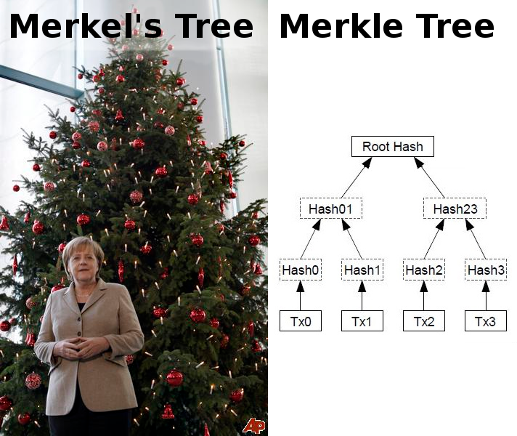
humor

Slide 30
Homework
Chap 3: Bitcoin Mechanics Bitcoin and Cryptocurrency Technologies: A Comprehensive Introduction
Proof of Work, Burn, Space (link)
An overview of Mastercoin (link)
P2SH (link)
Blockchain exploration: blockchain.info (link)
Distribution of nodes (link)
28

